Slide 1
GLOBAL SUPERSTORE DATA WAREHOUSE & BI ANALYTICS SYSTEM
Team Alpha: Sakshi Singh, Shivani Pandeti, Amulya Walimbe, Reeya Patra
Course: IST 722

Slide 2
Project Overview
This project delivers a complete end-to-end Data Warehouse + BI Insights System using Snowflake and Power BI.
We converted raw Global Superstore data into a high-performance analytical model that supports sales analytics, customer insights, product performance, and shipping efficiency.

Slide 3
BUSINESS PROBLEM
THE ORGANIZATION HAD:
Large volumes of sales data
No centralized warehouse
Slow, repetitive reporting
No unified view of customers, products, or regions
No automated KPI calculations
GOAL: Build a scalable warehouse + dashboards to support fast decision-making.

Slide 4
OBJECTIVE
Transform raw transactional data into analytical format
Build a Snowflake-based warehouse with conformed dimensions
Automate the ETL pipeline (Extract → Transform → Load)
Produce enterprise-grade dashboards for four business processes
Enable trend analysis, regional performance, customer segmentation, and delivery KPIs

Slide 5
DATA SOURCES
Global Superstore Dataset ~51K rows, 24 attributes
Dataset Includes:
Orders
Customers
Products
Geography
Discounts
Shipping performance
Provided as CSV → loaded into Snowflake RAW_STAGE

Slide 6
System Architecture
Three-Layer Data Warehouse Architecture
RAW_STAGE
  Raw CSV data
  No transformations
TRANSFORM Layer
  Surrogate keys
  Cleaning, standardization
  Fact & Dimension build
DW Layer
  Presentation-ready tables
  Used by Power BI

Slide 7
ETL METHODOLOGY
Extract:
CSV loaded to Snowflake internal stage
STG_GLOBAL_SUPERSTORE created
Data type validation and consistency checks
Transform:
Cleaned and standardized records
Generated MD5 surrogate keys
Built 5 Dimensions + 4 Fact Tables
Business rules (margin, days-to-ship, monthly rollups)
Load:
Moved validated objects into DW schema
Ensured referential integrity & row count consistency

Slide 8
KEY TRANSFORMATIONS IMPLEMENTED
MD5-based surrogate keys for geography & shipping
Role-playing date dimension (Order Date / Ship Date)
Monthly aggregations for customer & product performance
Shipping delay calculation using DATEDIFF
Profit margin, AOV, repeat purchase metrics
Regional segmentation & market mapping

Slide 9
STAR SCHEMA MODEL
Conformed Dimensions:
DIM_DATE
DIM_CUSTOMER
DIM_PRODUCT
DIM_GEOGRAPHY
DIM_SHIPPING
Fact Tables:
FACT_SALES
FACT_SHIPPING
FACT_CUSTOMER_MONTHLY
FACT_PRODUCT_MONTHLY

Slide 10
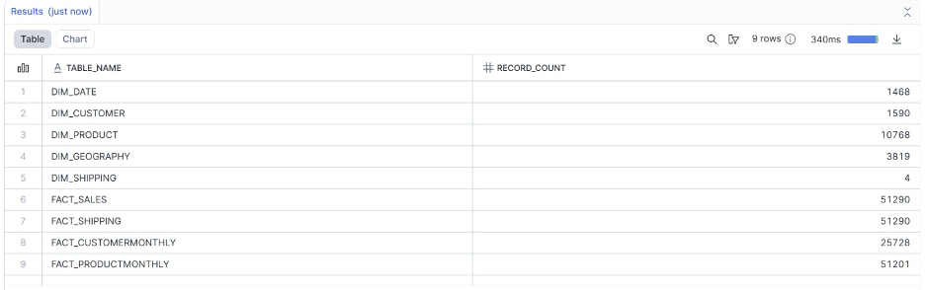
Data Validation Checks
Row count reconciliation between Stage → Transform → DW
Duplicate key checks
Null key detection
Date continuity between Order Date and Ship Date
Profit, Discount, Quantity sanity checks
Late/On-time shipping logic validation
Referential integrity for all surrogate keys

Slide 11
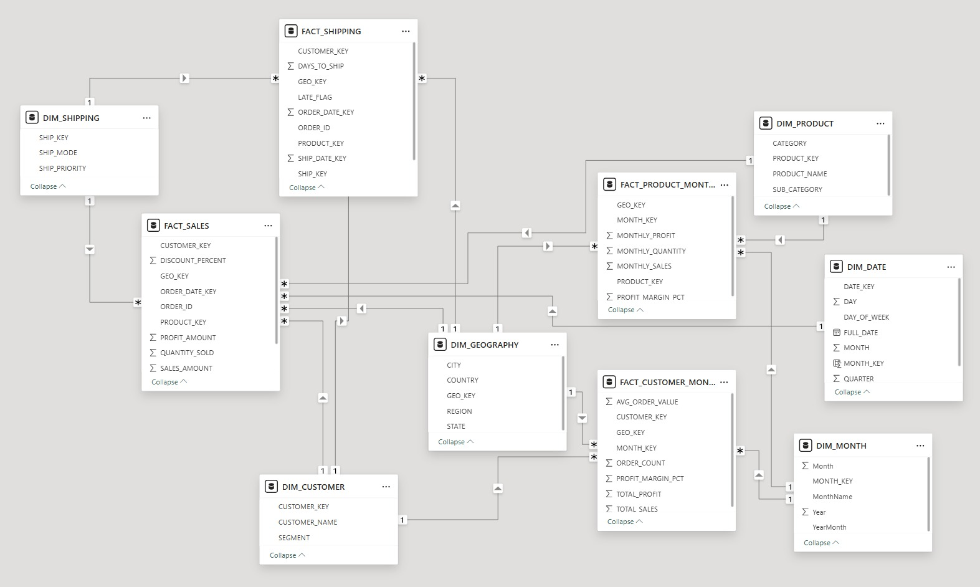
BI - Layer Overview (Power BI)
The BI solution is divided into 4 business dashboards:
Sales Overview
Product Performance
Customer Insights
Shipping & Delivery Performance
Designed for:
Executives
Category Managers
Logistics teams
Customer Relationship teams

Slide 12
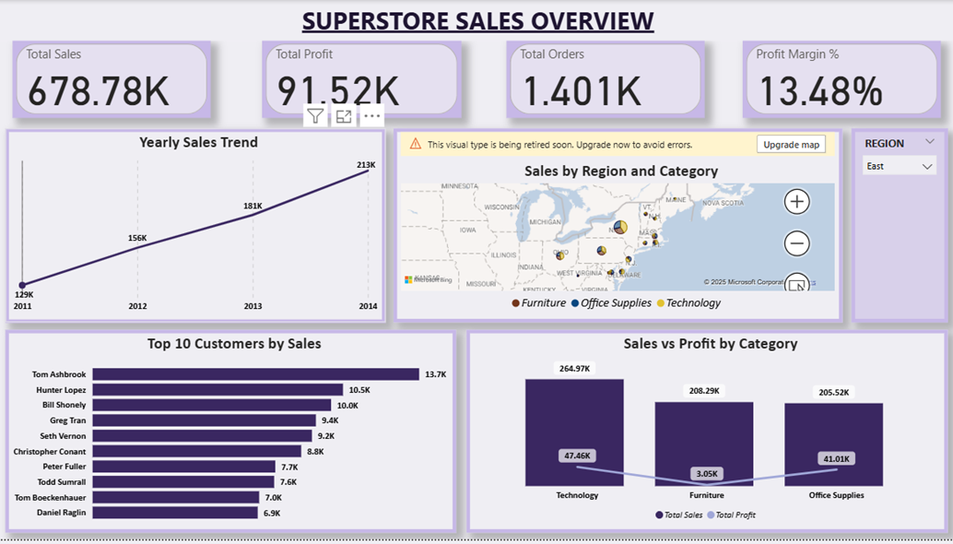
Dashboard 1 — Sales Overview
Key Metrics Displayed
Total Sales, Profit, Orders, Profit Margin
Yearly trend analysis
Regional sales breakdown
Top 10 customers
Sales & profit by category
Insight:
Steady YoY sales growth
Technology contributes highest revenue
East region is the dominant market
Top 10 customers drive a large % of revenue

Slide 13
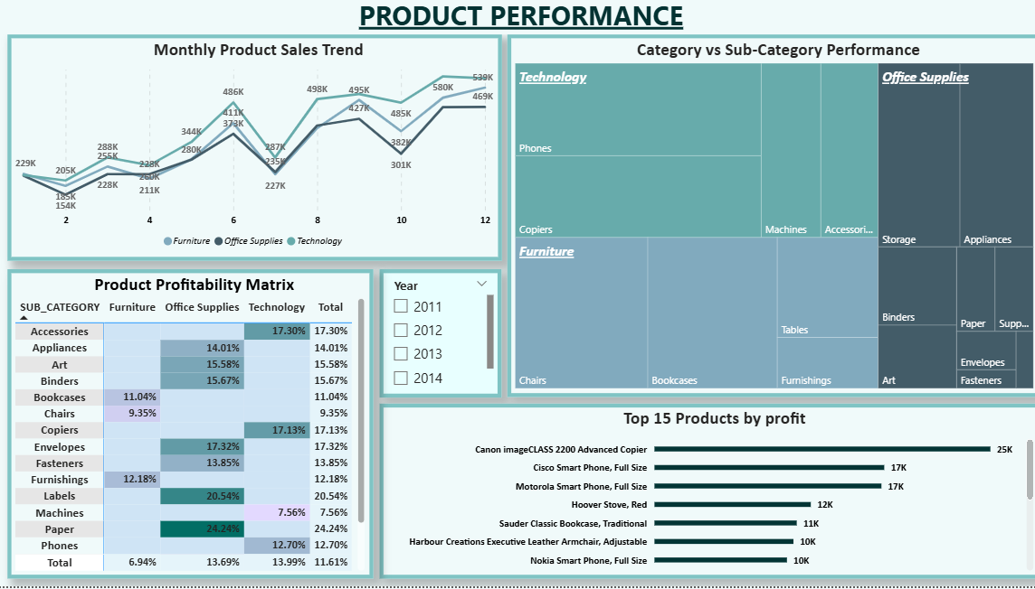
Dashboard 2 — Product Performance
Key Metrics Displayed
Monthly sales trend by category
Category vs sub-category treemap
Profitability matrix
Top 15 products by profit
Insights
Q4 peak visible in all years
Phones, Chairs → high performers
Bookcases, Furnishings → low profitability
Technology has highest margins

Slide 14
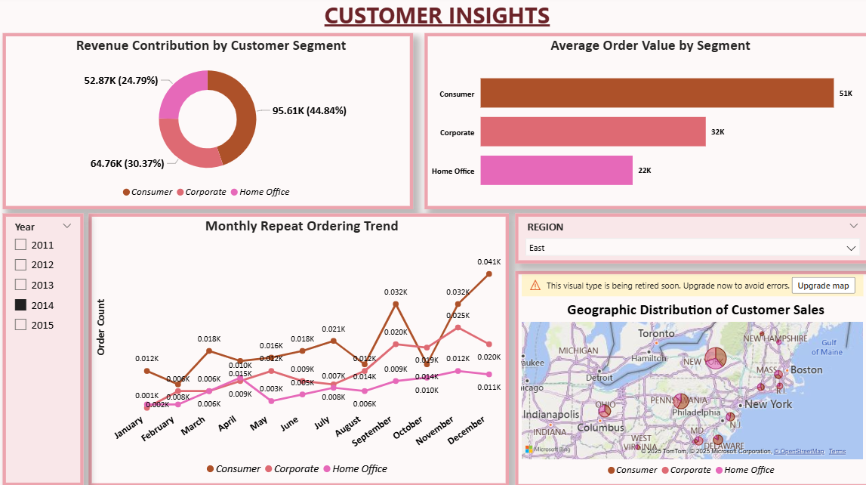
Dashboard 3 — Customer Insights
Key Metrics Displayed
Segment-wise revenue distribution
Average order value by segment
Monthly repeat ordering trend
Customer location map
Insights
Consumer segment contributes ~50%
Corporate has higher AOV
Repeat orders increasing over time
East and West regions dominate customer base

Slide 15
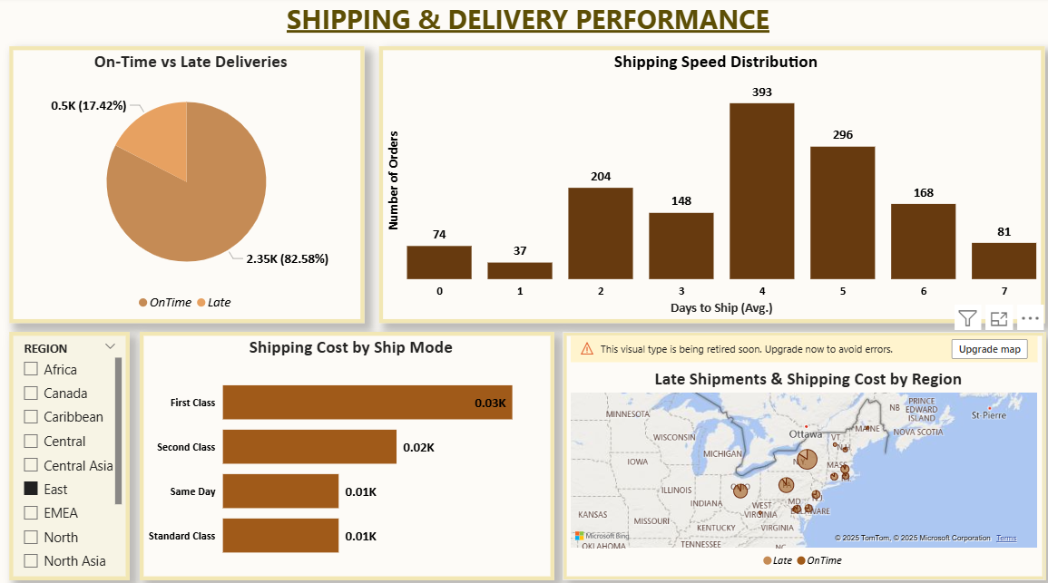
Dashboard 4 — Shipping & Delivery Performance
Key Metrics Displayed
On-time vs Late deliveries
Days-to-ship distribution
Shipping cost by mode
Region-wise delivery risks
Insights
~17% deliveries are late
Standard & Second Class dominate volume
4–5 day shipping is most common
APAC & EMEA regions show higher delays

Slide 16
Business Impact
The system helps stakeholders:
Monitor revenue growth & profitability
Identify high-value customers and retention trends
Optimize product mix using profitability insights
Improve logistics efficiency by analyzing late shipments
Reduce operational bottlenecks through data-driven visibility

Slide 17
Conclusion
Successfully built an end-to-end analytics system using Snowflake and Power BI.
Transformed raw, unclean CSV data into a structured, validated data warehouse.
Delivered four business dashboards offering clear insights across sales, customers, products, and shipping.
The final solution is scalable, accurate, and aligned with real industry data-engineering practices.
Reflection
Learned the importance of proper data cleaning and staging.
Understood why grain, surrogate keys, and conformed dimensions matter.
Gained hands-on experience building ETL pipelines and star-schema models.
Realized how small transformation errors can impact final insights.

